Slide 1
宇宙論的シミュレーションにおける 初代星フィードバックの 初代星質量およびハロー質量依存性
北海道大学理学院宇宙理学専攻 修士1年
松田 凌
Notes:
Thank you for introduction. I will talk about my graduation research presentation. The title is the effects of ionizing radiation and supernovae of the first stars on their surroundings.

Slide 2
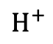
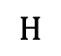
Introduction - 初代星研究の重要性 -
$$H$$
初代星による影響 (フィードバック)
UV光子の放射
超新星爆発によるエネルギーや金属供給
宇宙の熱的・化学的な性質が変化
初代星による周囲へのフィードバックは、初代銀河やその後の宇宙の進化に 大きな影響を及ぼしたはず
初代星フィードバックの効果を理解することは重要
$$H^{+}$$
エネルギー・金属
UV
SN
図は+20
Notes:
Then, I will talk about the importance of researching the first stars.
The thermal and chemical properties of the universe are changed by ionizing photon radiation and metal provision from supernova explosions of the first stars.
So, the feedback of the first stars on their surroundings has a significant impact on the evolution of the universe. Therefore, it is crucial to understand the effects of feedback.

Slide 3
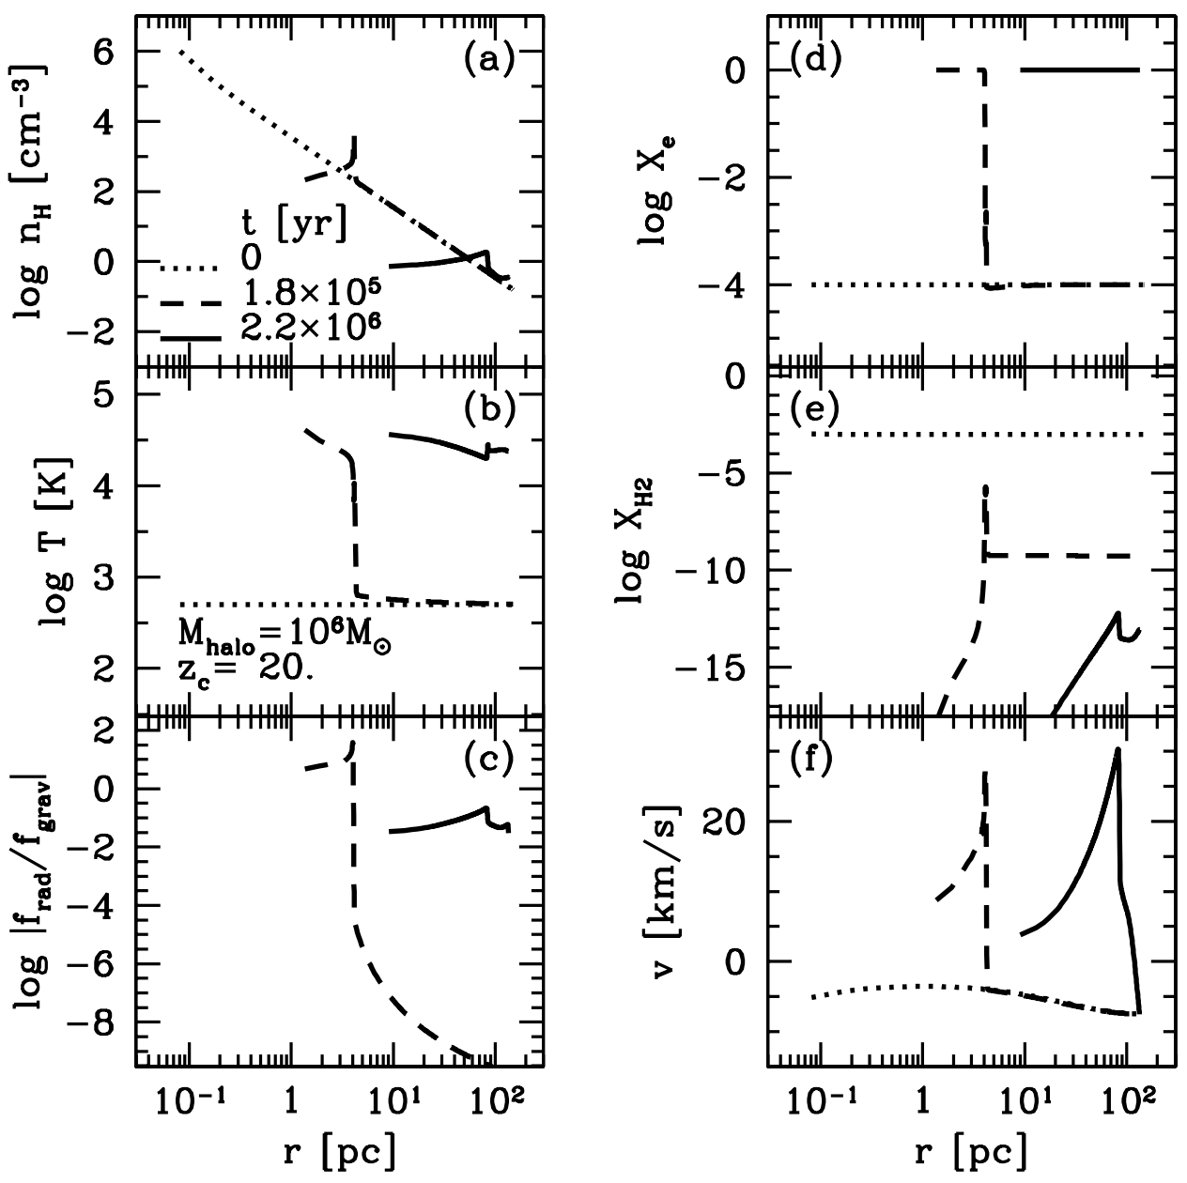
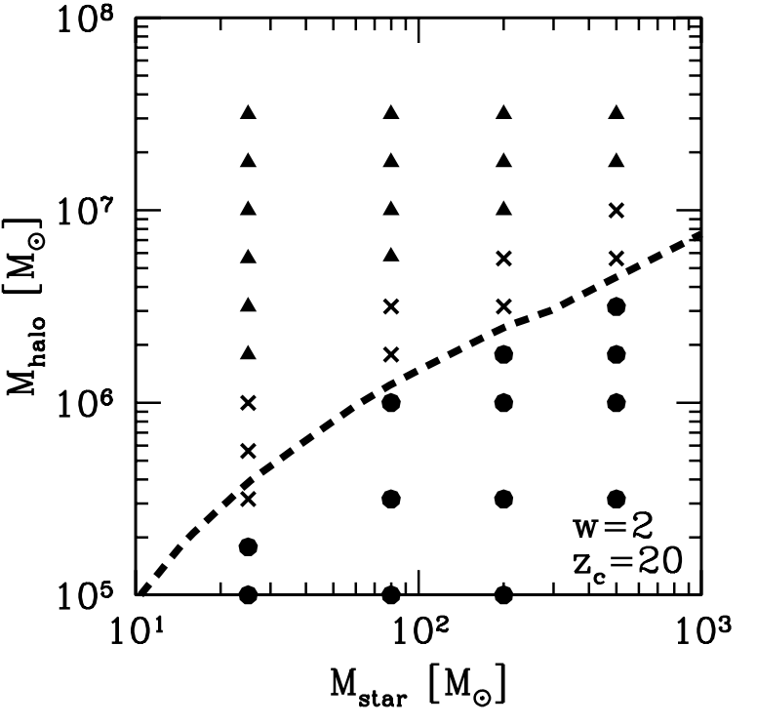
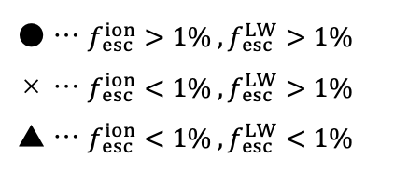
Introduction - 初代星フィードバックの先行研究1 -
Kitayama et al. (2004)
球対称1次元計算
初代星の質量とハローの質量を複数設定して計算
電離バブルの進化に着目
● … $f_{ esc}^{ion}>1\% ,f_{ esc}^{LW}>1\%$
× … $f_{ esc}^{ion}<1\% ,f_{ esc}^{LW}>1\%$
▲ … $f_{ esc}^{ion}<1\% ,f_{ esc}^{LW}<1\%$
Chiaki+18
Notes:
I will introduce some of the previous studies.
(Kitayama et al. 2004) and (Kitayama&Yoshida 2005) performed spherically symmetric 1D calculations to study the evolution process of the ionized and supernova bubbles by changing the stellar masses and halo masses.
(Chiaki et al. 2018) performed a three-dimensional cosmological simulations to study the evolution to next generation star formation.

Slide 4
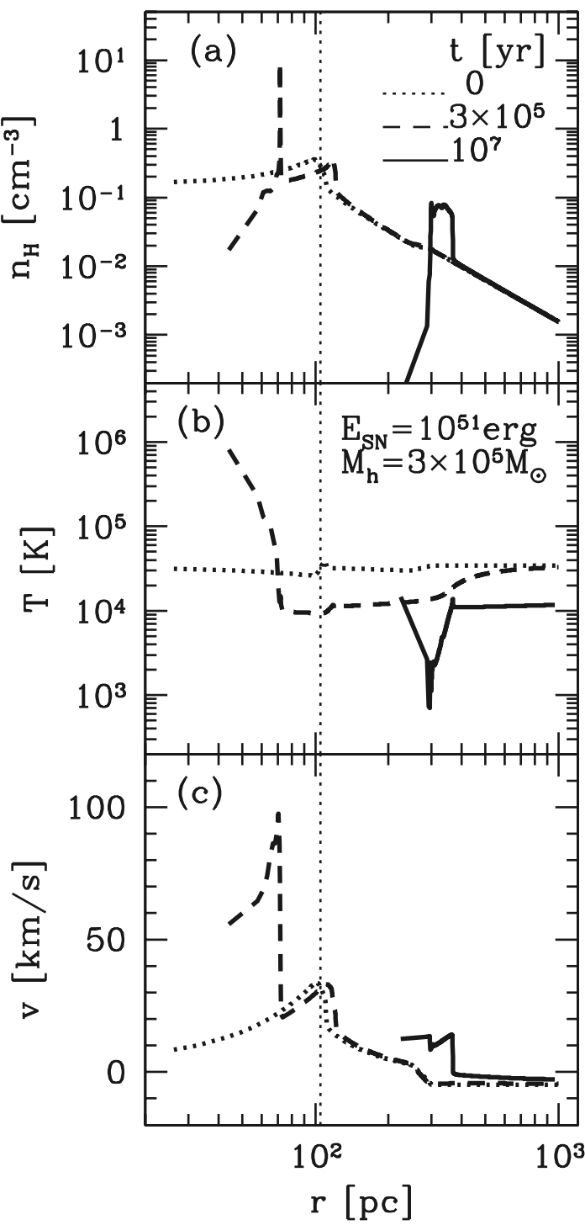
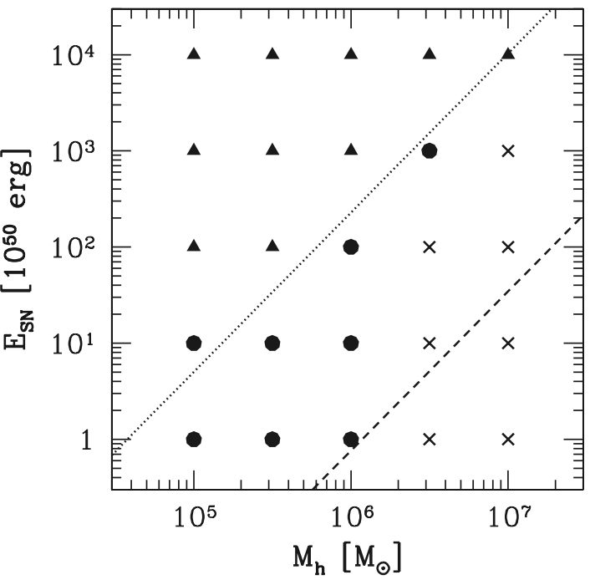
Introduction - 初代星フィードバックの先行研究2 -
Kitayama & Yoshida (2005)
球対称1次元計算
超新星爆発エネルギーと ハローの質量を複数設定して計算
超新星バブルの進化に着目
3次元シミュレーションでない
▲ … 電離バブルが広がっていなくても 超新星バブルが広がる
● … 電離バブルが広がっているときのみ 超新星バブルが広がる
× … 超新星バブルが広がらない
Chiaki+18
Notes:
I will introduce some of the previous studies.
(Kitayama et al. 2004) and (Kitayama&Yoshida 2005) performed spherically symmetric 1D calculations to study the evolution process of the ionized and supernova bubbles by changing the stellar masses and halo masses.
(Chiaki et al. 2018) performed a three-dimensional cosmological simulations to study the evolution to next generation star formation.

Slide 5
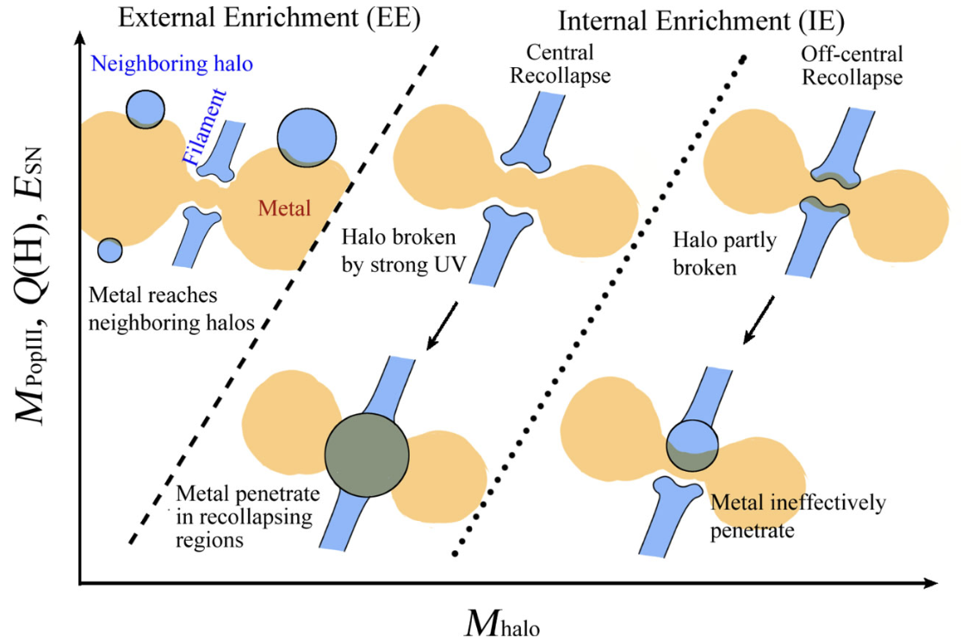
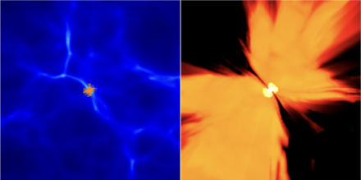
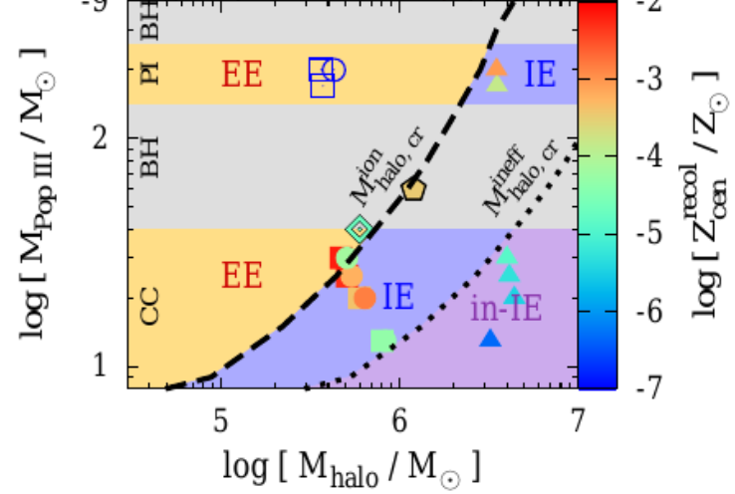
Introduction - 初代星フィードバックの先行研究3 -
Chiaki et al. (2018)
3次元宇宙論的シミュレーション
次の星形成時の金属度に着目
3つのハローでしか調べられていない
フィードバックがどこまで広がるかについて詳しく調べられていない
超新星爆発エネルギーが星質量と一対一に決められている
Chiaki+18
Notes:
I will introduce some of the previous studies.
(Kitayama et al. 2004) and (Kitayama&Yoshida 2005) performed spherically symmetric 1D calculations to study the evolution process of the ionized and supernova bubbles by changing the stellar masses and halo masses.
(Chiaki et al. 2018) performed a three-dimensional cosmological simulations to study the evolution to next generation star formation.

Slide 6
Introduction - 本研究の目的 -
先行研究は1次元計算だったり、次の世代の星形成に重点を置いていたりする。
性質の異なる初代星やハローによって、電離光子がどのように周囲に放出されたかや 超新星バブルがどのように広がったかについて、3次元シミュレーションで 系統的に調べられているわけではない。
本研究では、以下のシミュレーションを行う。
電離バブルや超新星バブルの広がり方について調べる
3次元宇宙論的シミュレーション
様々な初期条件 (複数の初代星質量、ハロー質量、ハローの個性)
Notes:
However, these previous studies are 1D calculations or focus on next generation star formation, and they do not systematically investigate how ionized bubbles and the supernova bubbles expand with different properties in 3D.
So, in this study, we perform the three-dimensional cosmological simulations to investigate the expansion of the ionized bubble and the supernova explosion of the first stars under various initial conditions (in this graduation research, by changing stellar masses).

Slide 7
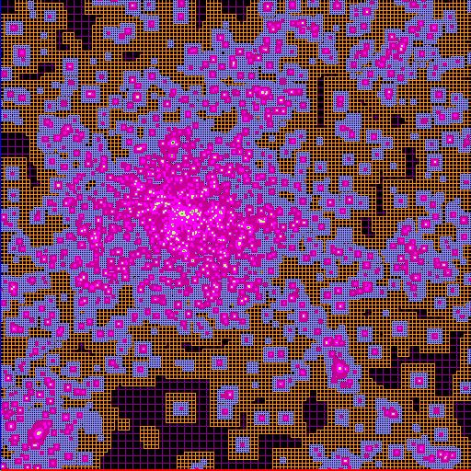

Method - シミュレーションコード -
"RAMSES-RT” (Rosdahl et al. 2013)
宇宙論的輻射流体コード
adaptive mesh refinement 法 高い解像度が必要な場所のグリッドをより細分化して解像度を上げることができる
初代銀河形成において重要になる物理過程のモデルが組み込まれているバージョンを利用 (Sugimura et al. 2024)
"MUSIC" (Hahn, 2011)
宇宙論的初期条件生成コード
宇宙の初期密度ゆらぎと整合的な初期条件から始める
Notes:
Then, I will explain the methods.
First, I introduce “RAMSES-RT”. This is the cosmological radiation hydrodynamics code, and this includes models of physical processes that are important in the formation of first galaxies. This code uses adaptive mesh refinement technique like in this figure. We use the extended version of the code developed for first galaxy simulations.
And, "MUSIC" is used to generate the cosmological initial conditions. This allows the simulation to start from initial conditions that reproduce the initial distribution of the universe.

Slide 8
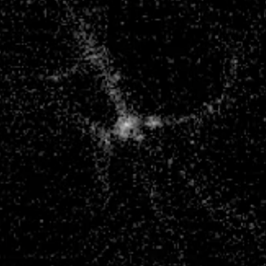
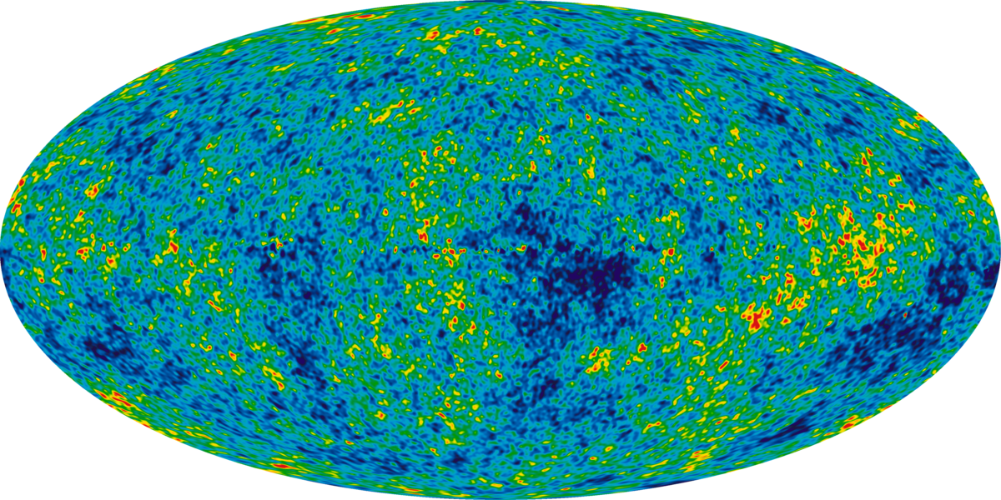
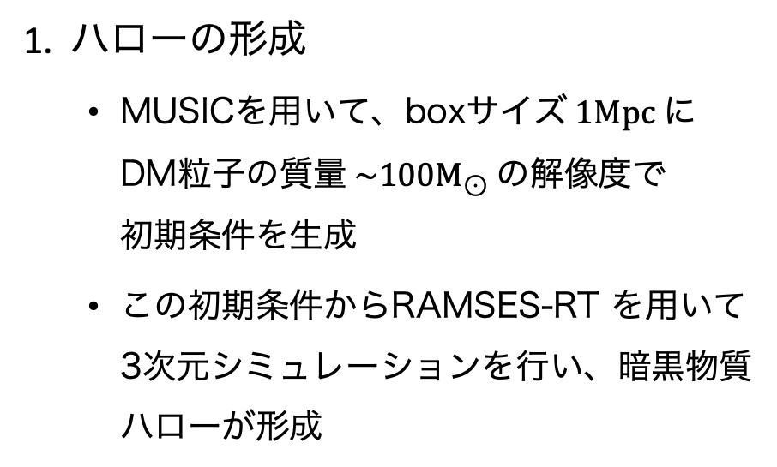
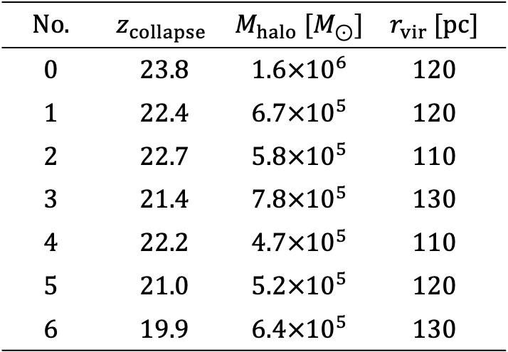
Method - シミュレーションの流れ -
ハロー
1. ハローの形成
MUSICを用いて、boxサイズ$1Mpc$に DM粒子の質量$\sim 100M_{⊙}$の解像度で 初期条件を生成
この初期条件からRAMSES-RT を用いて 3次元シミュレーションを行い、暗黒物質 ハローが形成
宇宙の初期密度ゆらぎ
Table 1. 各ハローの性質
$$No.$$ | $$z_{collapse}$$ | $$M_{halo} [M_{⊙}]$$ | $$r_{vir} [pc]$$
$$0$$ | $$23.8$$ | $$1.6×{10}^{6}$$ | $$120$$
$$1$$ | $$22.4$$ | $$6.7×{10}^{5}$$ | $$120$$
$$2$$ | $$22.7$$ | $$5.8×{10}^{5}$$ | $$110$$
$$3$$ | $$21.4$$ | $$7.8×{10}^{5}$$ | $$130$$
$$4$$ | $$22.2$$ | $$4.7×{10}^{5}$$ | $$110$$
$$5$$ | $$21.0$$ | $$5.2×{10}^{5}$$ | $$120$$
$$6$$ | $$19.9$$ | $$6.4×{10}^{5}$$ | $$130$$
Notes:
I will talk about flow of the simulations.
First, a halo is created in a cosmological simulation from the initial distribution of the universe. Then, the first star is placed at the center of the halo. Four models with different masses of the first star are prepared. The properties of each simulation are given in Table 1.
Then, the star emits ionizing photons until the end of its lifetime.
At the end of the lifetime, a supernova explosion occurs and metal is ejected. The photon emission rate and supernova explosion energy are set according to the stellar mass.

Slide 9

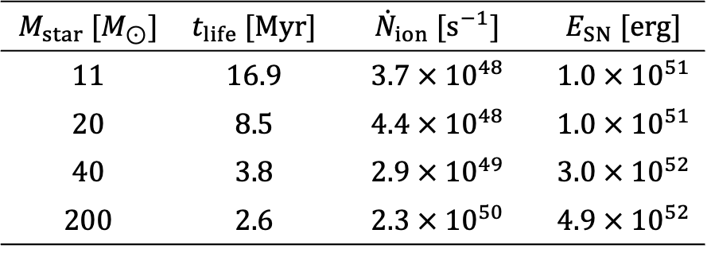
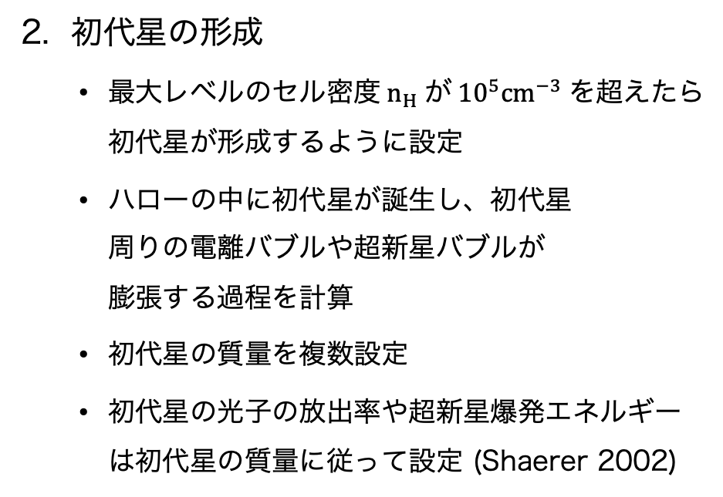
Method - シミュレーションの流れ -
ハロー
星が誕生
2. 初代星の形成
最大レベルのセル密度$n_{H}$が${10}^{5}cm^{−3}$を超えたら初代星が形成するように設定
ハローの中に初代星が誕生し、初代星 周りの電離バブルや超新星バブルが 膨張する過程を計算
初代星の質量を複数設定
初代星の光子の放出率や超新星爆発エネルギーは初代星の質量に従って設定 (Shaerer 2002)
$$z=23.8 \\ r_{ halo}=120 pc$$
Table 2. 各初代星の性質
$$M_{star} [M_{⊙}]$$ | $$t_{life} [Myr]$$ | $${\dot{N}}_{ion} [s^{−1}]$$ | $$E_{SN} [erg]$$
$$11$$ | $$16.9$$ | $$3.7 × {10}^{48}$$ | $$1.0 × {10}^{51}$$
$$20$$ | $$8.5$$ | $$4.4 × {10}^{48}$$ | $$1.0 × {10}^{51}$$
$$40$$ | $$3.8$$ | $$2.9 × {10}^{49}$$ | $$3.0 × {10}^{52}$$
$$200$$ | $$2.6$$ | $$2.3 × {10}^{50}$$ | $$4.9 × {10}^{52}$$
Notes:
I will talk about flow of the simulations.
First, a halo is created in a cosmological simulation from the initial distribution of the universe. Then, the first star is placed at the center of the halo. Four models with different masses of the first star are prepared. The properties of each simulation are given in Table 1.
Then, the star emits ionizing photons until the end of its lifetime.
At the end of the lifetime, a supernova explosion occurs and metal is ejected. The photon emission rate and supernova explosion energy are set according to the stellar mass.

Slide 10
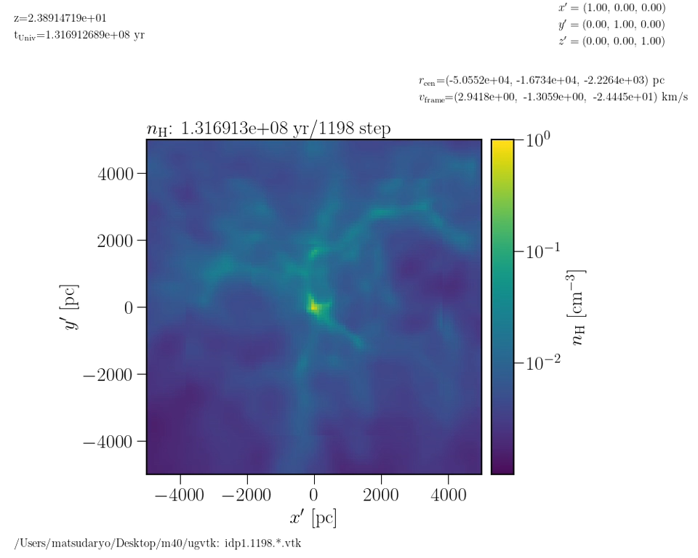
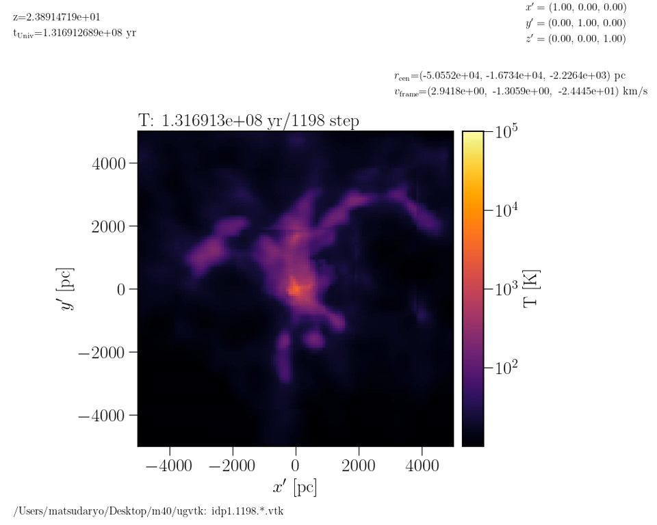
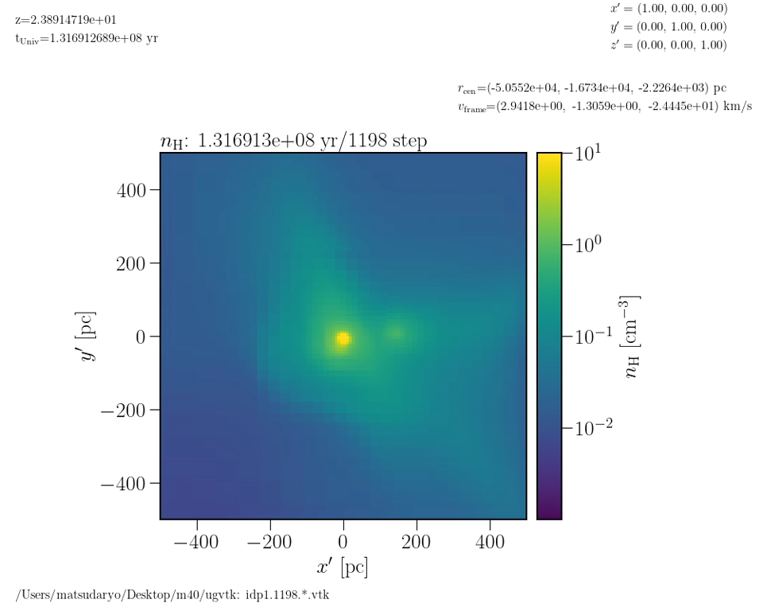
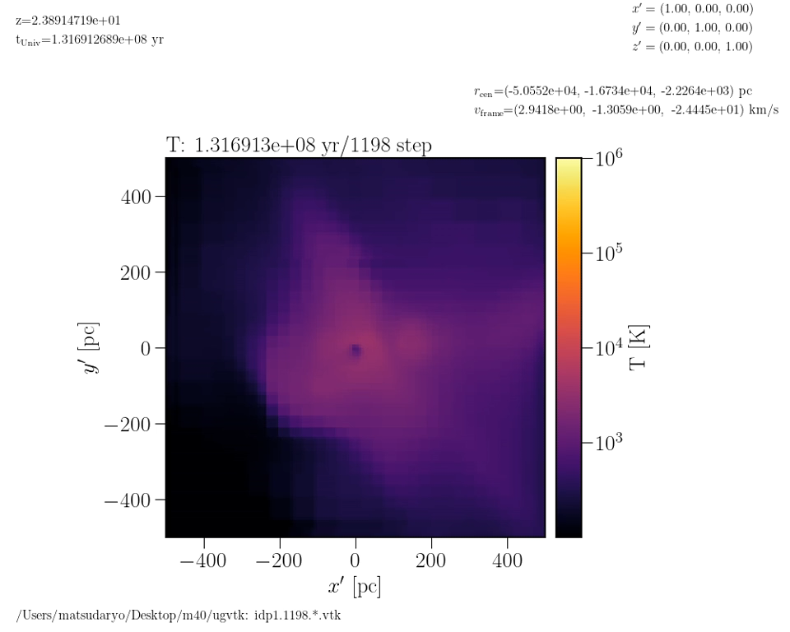
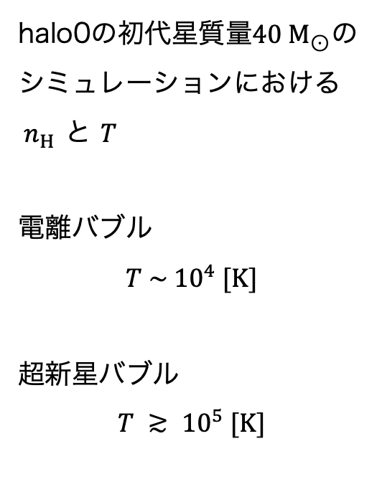
Results - 2D ムービー -
halo0の初代星質量$40 M_{⊙}$の シミュレーションにおける $n_{H}$ と $T$
電離バブル
$$T \sim {10}^{4} [K]$$
超新星バブル
$$T ≳ {10}^{5} [K]$$
1 kpc
1 kpc
0.1 kpc
0.1 kpc
Notes:
Then, I will talk about the results from this section.
These movies are 2D plots of hydrogen density and temperature of the m40 simulation. The top figure shows 10 kpc per side, and the bottom figure shows the center of the top figure. The temperature of ionized bubbles is about ten to (the power of) four Kelvin and of supernova bubbles is above ten to (the power of) five Kelvin. We can see that the ionized bubble expands first, and then the supernova bubble expands.

Slide 11
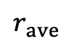
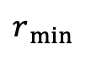
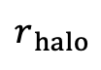
Results - 電離バブルの進化 -
$$r_{ ave}$$
$$r_{ min}$$
バブル
m40, m200
バブルの最小半径がハローの半径を超える
m11
バブルの平均半径がハローの半径を超えない
m20
バブルの平均半径はハローの半径を超える一方、 バブルの最小半径がハローの半径を超えない
初代星の質量によって電離バブルの広がり方が大きく変わる
実線 : 平均半径
破線 : 最小半径
SN
$$r_{ halo}$$
Notes:
I will talk about the evolution of the ionized bubbles.
The time evolution of the radius of the ionized bubbles until supernova for each simulation is shown in this figure. The solid line shows the average radius of the bubbles, and the dashed line shows the minimum radius of the bubbles. The horizontal dotted line in the figure shows the halo radius.
The simulations for m40 and m200 show that the bubble expand beyond the halo radius.
In the case of m11, the bubble does not expand beyond the halo radius.
In the case of m20, the average radius of the bubble exceeds the halo radius, but the minimum radius of bubble does not exceed the halo radius. This indicates that the ionized bubble of m20 expands only in a certain direction and does not expand over the entire halo.
We find that the expansion of the ionized bubbles differs depending on the mass of the first stars.

Slide 12
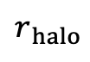
Results - 超新星バブルの進化 -
実線 : 平均半径
破線 : 最小半径
m40, m200
バブルの最小半径がハローの半径を超える
m11, m20
バブルの平均半径はハローの半径を超える一方、 バブルの最小半径がハローの半径を超えない
初代星の質量によって超新星バブルの広がり方も大きく変わる
$$r_{ halo}$$
new stars (Pop II)
Notes:
Next, I will talk about the evolution of the supernova bubbles.
The time evolution of the radius of the supernova bubbles is shown in this figure.
For m40 and m200, even the minimum radius of bubble exceeds the halo radius, so the supernova bubble expands beyond the halo radius. On the other hand, for m11 and m20, although the average radius of bubble exceeds the halo radius, the minimum radius does not exceed the halo radius. This indicates that the supernova bubbles of m11 and m20 expands only in a certain direction and does not expand over the entire halo.
The second stage of expansion in m11 is due to the new star formation.
We find that the expansion of the supernova bubbles differs depending on the mass of the first stars.

Slide 13
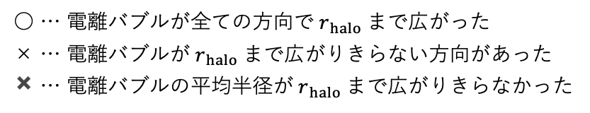
Results - 電離フィードバックの星質量依存性 -
○ … 電離バブルが全ての方向で$r_{ halo}$まで広がった
× … 電離バブルが$r_{ halo}$まで広がりきらない方向があった
✖️ … 電離バブルの平均半径が$r_{ halo}$まで広がりきらなかった
初代星の質量が大きくなるほど、電離バブルは十分にハローを越えて広がる
電離フィードバックは星質量が大きくなるほど遠くへ広がる傾向がある
halo0
Notes:
In this section, I discuss the critical mass of efficient feedback.
The dotted line in the figure shows the boundary of whether the ionized bubble expands or not in 1D calculation from Kitayama et al.(2004). According to this line, the ionized bubble is more expanded for larger stellar masses, which is consistent with our results.
In this study, we consider that there is a critical mass for bubble expansion between m20 and m40. But, from 1D calculations, the critical mass is between m40 and m200. So, the critical mass for bubble expansion of this study is different from 1D calculations. Possible reasons for this difference are the effects of the lower resolution and the three-dimensional effects. In order to find the reason of this difference, we think that more detailed simulations with higher resolution are needed in the future.

Slide 14
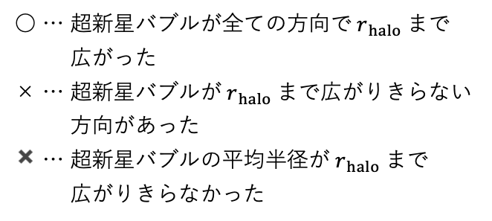
Results - 超新星フィードバックの星質量依存性-
○ … 超新星バブルが全ての方向で$r_{ halo}$まで 広がった
× … 超新星バブルが$r_{ halo}$まで広がりきらない 方向があった
✖️ … 超新星バブルの平均半径が$r_{ halo}$まで 広がりきらなかった
初代星の質量が大きくなるほど、超新星バブルはよりハローを越えて広がる傾向がある
電離バブルが十分に広がらなかったm11, m20では、超新星バブルも十分に広がらなかった
電離フィードバックのかかり方が、超新星バブルのフィードバックに 影響を与えている
halo0
Notes:
In this section, I discuss the critical mass of efficient feedback.
The dotted line in the figure shows the boundary of whether the ionized bubble expands or not in 1D calculation from Kitayama et al.(2004). According to this line, the ionized bubble is more expanded for larger stellar masses, which is consistent with our results.
In this study, we consider that there is a critical mass for bubble expansion between m20 and m40. But, from 1D calculations, the critical mass is between m40 and m200. So, the critical mass for bubble expansion of this study is different from 1D calculations. Possible reasons for this difference are the effects of the lower resolution and the three-dimensional effects. In order to find the reason of this difference, we think that more detailed simulations with higher resolution are needed in the future.

Slide 15

Results - 初代星フィードバックの臨界質量 -
○ … 電離バブルが全ての方向で$r_{ halo}$まで広がった
× … 電離バブルが$r_{ halo}$まで広がりきらない方向があった
✖️ … 電離バブルの平均半径が$r_{ halo}$まで広がりきらなかった
初代星質量が大きいほど電離バブルが広がる
ハローの質量が大きくなると、小さい質量の星で電離バブルが広がらなくなる
Kitayama et al. (2004)の 1次元計算と一致する傾向
1次元計算と比べ、全体的に電離バブルがより広がっている傾向にある
解像度の問題？
電離バブルが広がる条件
(1D; Kitayama+04)
Notes:
In this section, I discuss the critical mass of efficient feedback.
The dotted line in the figure shows the boundary of whether the ionized bubble expands or not in 1D calculation from Kitayama et al.(2004). According to this line, the ionized bubble is more expanded for larger stellar masses, which is consistent with our results.
In this study, we consider that there is a critical mass for bubble expansion between m20 and m40. But, from 1D calculations, the critical mass is between m40 and m200. So, the critical mass for bubble expansion of this study is different from 1D calculations. Possible reasons for this difference are the effects of the lower resolution and the three-dimensional effects. In order to find the reason of this difference, we think that more detailed simulations with higher resolution are needed in the future.

Slide 16
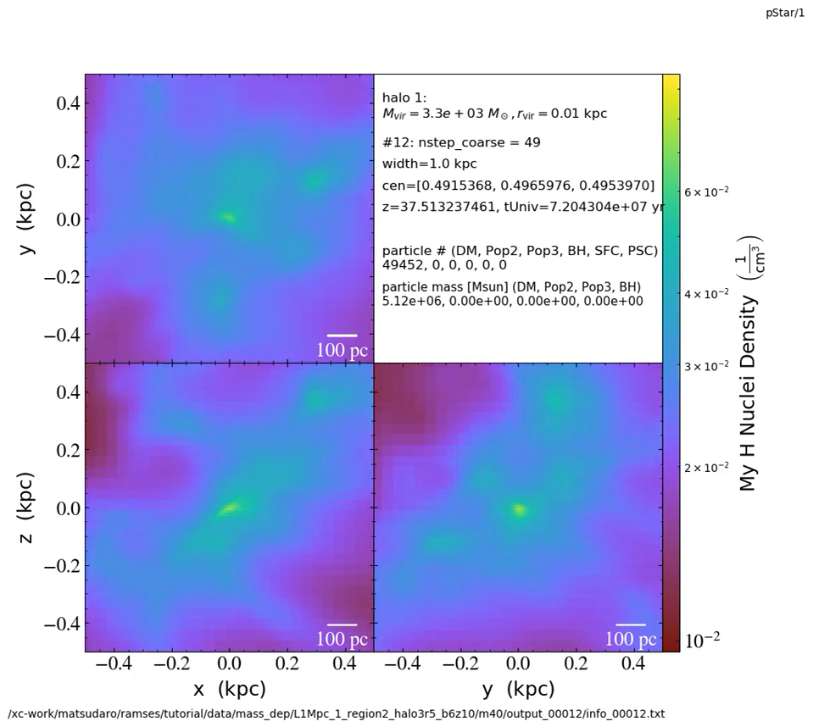
Discussion - 例外的なケースの紹介 -
○ … 電離バブルが全ての方向で$r_{ halo}$まで広がった
× … 電離バブルが$r_{ halo}$まで広がりきらない方向があった
✖️ … 電離バブルの平均半径が$r_{ halo}$まで広がりきらなかった
1次元計算と傾向が一致しない例も存在
DM衝突中に星形成し、電離バブルが広がる間に密度の高い点が〜50pc付近に存在 (halo3)
halo3
Notes:
In this section, I discuss the critical mass of efficient feedback.
The dotted line in the figure shows the boundary of whether the ionized bubble expands or not in 1D calculation from Kitayama et al.(2004). According to this line, the ionized bubble is more expanded for larger stellar masses, which is consistent with our results.
In this study, we consider that there is a critical mass for bubble expansion between m20 and m40. But, from 1D calculations, the critical mass is between m40 and m200. So, the critical mass for bubble expansion of this study is different from 1D calculations. Possible reasons for this difference are the effects of the lower resolution and the three-dimensional effects. In order to find the reason of this difference, we think that more detailed simulations with higher resolution are needed in the future.

Slide 17
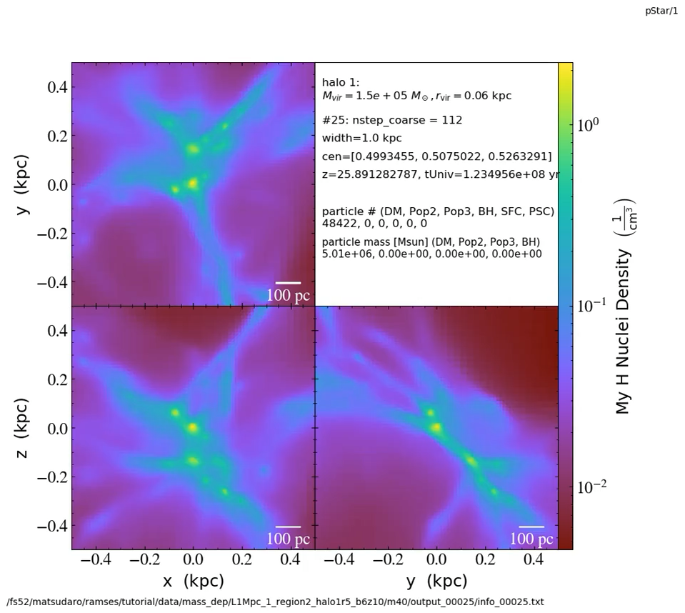
Discussion -例外的なケースの紹介 -
○ … 電離バブルが全ての方向で$r_{ halo}$まで広がった
× … 電離バブルが$r_{ halo}$まで広がりきらない方向があった
✖️ … 電離バブルの平均半径が$r_{ halo}$まで広がりきらなかった
1次元計算と傾向が一致しない例も存在
初めにできた星が超新星爆発を起こす前に、 新たな星が〜100pc付近に形成 (halo1)
halo1
Notes:
In this section, I discuss the critical mass of efficient feedback.
The dotted line in the figure shows the boundary of whether the ionized bubble expands or not in 1D calculation from Kitayama et al.(2004). According to this line, the ionized bubble is more expanded for larger stellar masses, which is consistent with our results.
In this study, we consider that there is a critical mass for bubble expansion between m20 and m40. But, from 1D calculations, the critical mass is between m40 and m200. So, the critical mass for bubble expansion of this study is different from 1D calculations. Possible reasons for this difference are the effects of the lower resolution and the three-dimensional effects. In order to find the reason of this difference, we think that more detailed simulations with higher resolution are needed in the future.

Slide 18
Discussion - ハローの個性の影響 -
○ … 電離バブルが全ての方向で$r_{ halo}$まで広がった
× … 電離バブルが$r_{ halo}$まで広がりきらない方向があった
✖️ … 電離バブルの平均半径が$r_{ halo}$まで広がりきらなかった
1次元計算と傾向が一致しない例も存在
halo1と同様に初めにできた星が超新星爆発を起こす前に、新たな星が 〜100pc付近に形成 (halo2)
ハローの個性によって電離バブルや超新星バブルの広がり方に違いが出てくる
初代星フィードバックを考える上で ハローの個性を十分に考慮する必要が ある
halo2
Notes:
In this section, I discuss the critical mass of efficient feedback.
The dotted line in the figure shows the boundary of whether the ionized bubble expands or not in 1D calculation from Kitayama et al.(2004). According to this line, the ionized bubble is more expanded for larger stellar masses, which is consistent with our results.
In this study, we consider that there is a critical mass for bubble expansion between m20 and m40. But, from 1D calculations, the critical mass is between m40 and m200. So, the critical mass for bubble expansion of this study is different from 1D calculations. Possible reasons for this difference are the effects of the lower resolution and the three-dimensional effects. In order to find the reason of this difference, we think that more detailed simulations with higher resolution are needed in the future.

Slide 19
Conclusion
初代星の電離バブルと超新星バブルの広がり方を調べる宇宙論的シミュレーションを行った。
初代星とハローの質量を複数設定し、電離バブルと超新星バブルの半径の時間進化をそれぞれ計算した。
全体的に初代星質量が大きく、ハローの質量が小さいほど、電離バブルが広がる傾向があることが分かり、この傾向は先行研究の1次元計算とも一致した。
超新星バブルも電離バブルと同じように広がる傾向があり、電離フィードバックのかかり方が、超新星バブルのフィードバックに影響を与えると考えられる。
一方で、ハローの個性によって電離バブルや超新星バブルの広がり方に違いが出てくることが明らかになったため、初代星フィードバックを考える上でハローの個性を十分に考慮する必要がある。
Notes:
This is my conclusion.
In this study, we perform the simulations investigating the expansion of the ionized bubble and the supernova explosion of the first star. We show the time evolution of the radius of the ionized and supernova bubbles at various stellar masses. We find that the mass of the first stars made a significant difference in the evolution of ionized and supernova bubbles. We are going to continue to perform simulations under various conditions to improve our understanding of feedback effects.
That's all for my presentation. Thank you for listening. (Do you have any questions?)

